Slide 1
PAYA
Lending technology that powers Kenya
Paya Ventures, Limited

Slide 2
Consumer lending is growing at rapid levels in Kenya, and the income benefit is attractive to financial institutions and traditional banks. Consumer lending via ecommerce channels and e-retail, is where the next niche penetrable market is at. But larger institutions in general, and financing capital more specifically, aren’t able to easily access these consumers.
Consumer loans are in demand.

Slide 3
Market Opportunity
Paya
Market
Consumer lending is continuously growing, and the demand on ecommerce channels is high.
Capital
Financial institutions can access the markets that will give them high yields.

Slide 4

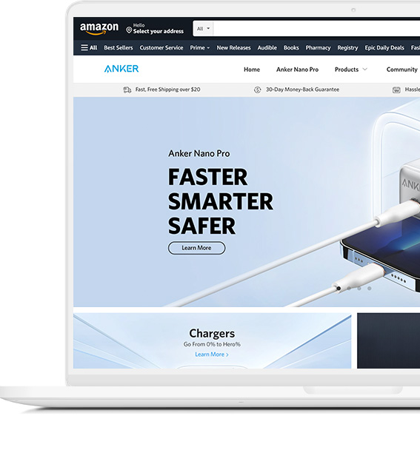
The Problem
Access to affordable capital, and access to high yield loans
Borrowers
Banks
New markets and ecommerce retailers create a demand for financing capital.
Want to access new loan sectors and new markets. Finding higher than average yield is a challenge.
35%
Average rate is 35%
13%
Average return is 13%

Slide 5
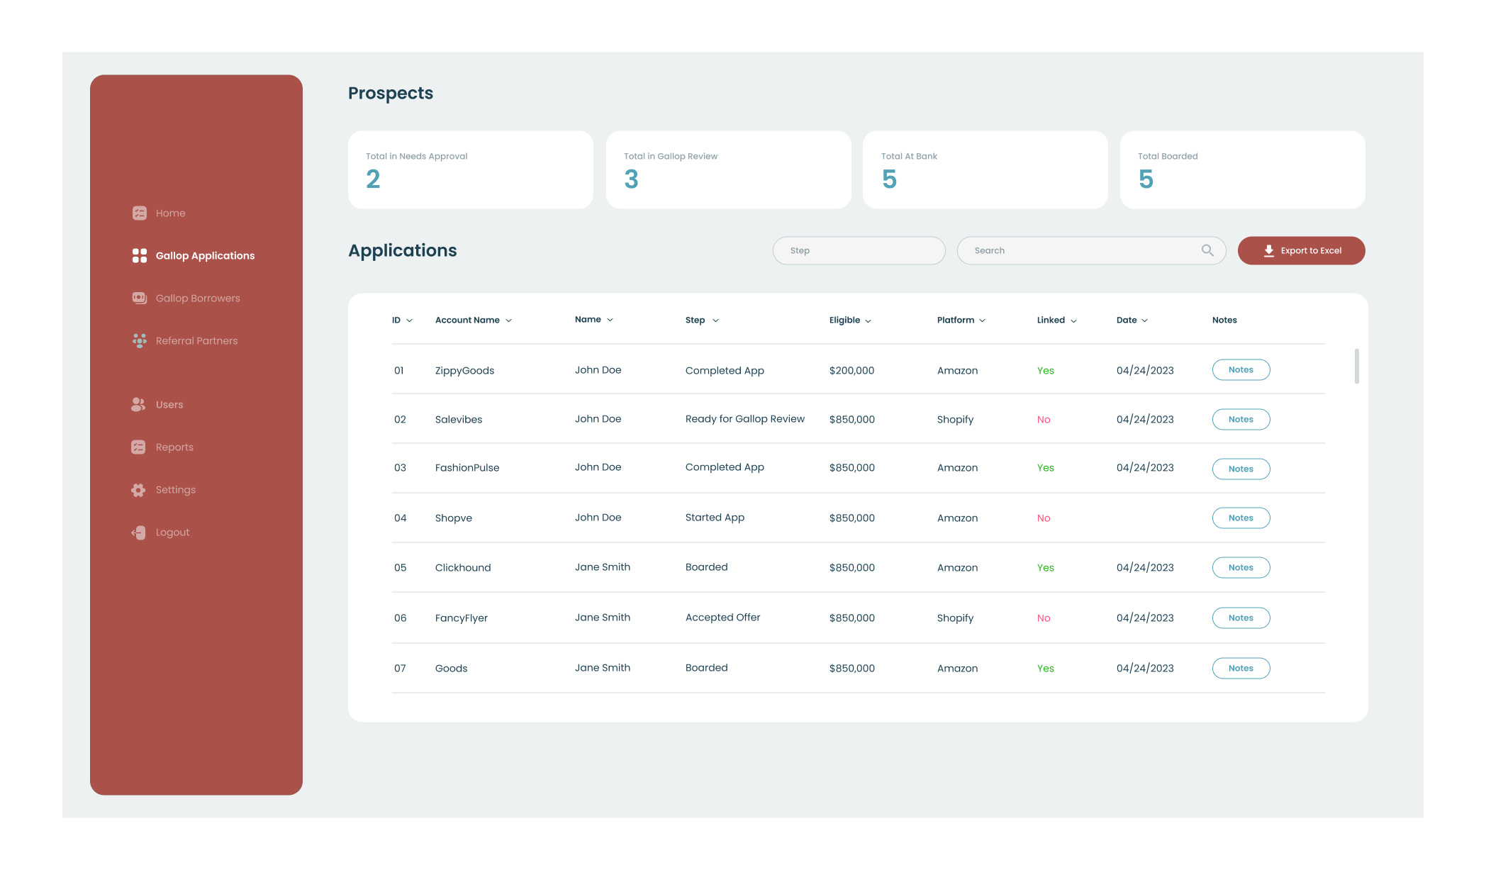
The Solution
Create a product that allows consumers to apply for a loan in 2 minutes, and finance their payments over time.
Borrowers
Banks
Consumers can apply for a buy now pay later loan in minutes, and get financed in a few minutes.
Can set the underwriting criteria and deploy an automated loan engine, with a deposit growth product
PAYA
50%
Cheaper capital
Ease-of-use tech
Data Analytics
Network Facilitator
1.3x
Higher Returns
Loan Originators
eCommerce marketplaces
Share revenue from referrals

Slide 6
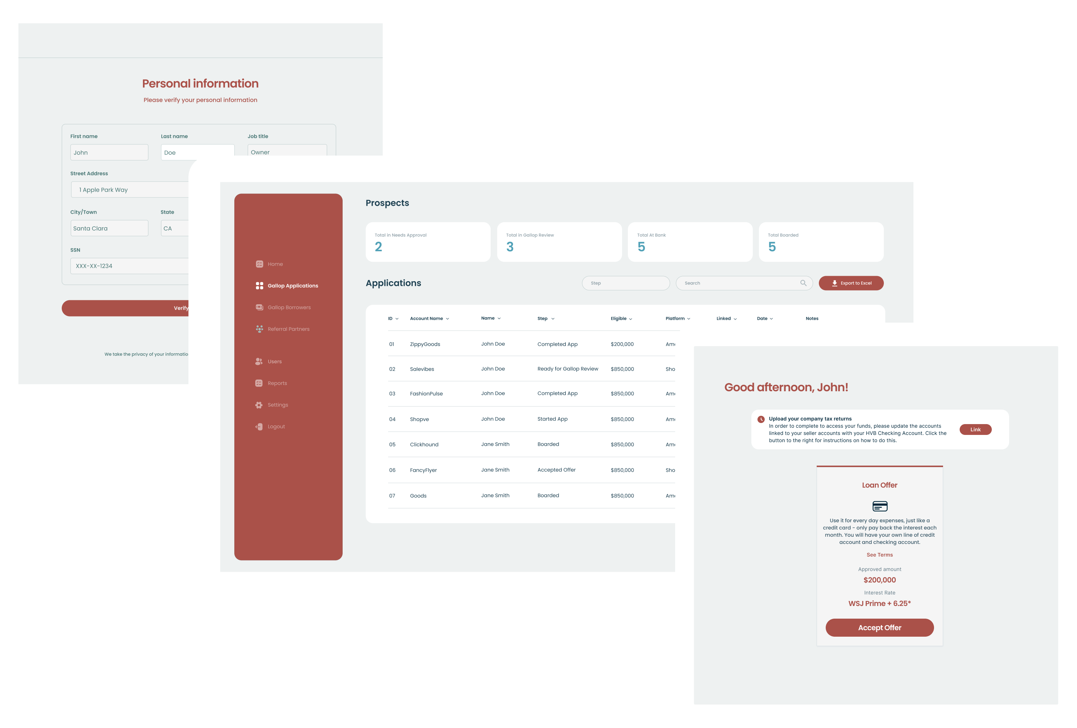
Solution
Easy and compliant application, automated underwriting and scalable backend management
Front-end application
Fully automated underwriting model producing real-time offers
Bank compliant for internal management and scalability
Deposit account growth
Notes:
Problem
eCom merchants want [better] access to capital
Banks want access to high quality and attractive yielding assets
Solution
Marketplace that empowers eCom SaaS companies to offer our loans to their customers at scale // and gives banks access to high quality/yielding assets
Double click on solution - our Moat
Our platform is (1) tech for eCom Saas, (2) data analytics and risk management systems, (3) access to capital at-scale (enabler to banks)
> scalable tech and data analytics unlocks the scalable low cost capital
Customer Quotes on our Solutions
[ ]
TAM
> Movement of eCom money and product is financable with our product - today we target Amazon and Shopify, we also have an immediate known opportunity walmart/ebay/etc, there is also social commerce (tiktok, whatsapp, voice) + whatever comes next
– because we are a scalable marketplace, we can apply to everyone
Unit Economics
> bank split, GG split, referral partner split (3%?)
> what that means for Gallop in dollars
>> self funding the growth bc it makes money…
GTM
> Include GTM on this page to show the immediate addressable revenue opportunity
> Case study on the left side // right side just have logos of partners > big number of total customers > big number of implied revenue
> i.e. Stay Tuned has 30k customers * 6% conversion rate based on prior partners * $100k per loan * x% margin
Why will we win? Reminder why we are the best
> [shane has notes on the page]
Team / Advisors

Slide 7




Total Addressable Market
Paya facilitates a connection between buyers and sellers
Emerging Commerce
TBD
Social commerce
Smart device automated purchasing
Voice-enabled purchase
Millions
Of Merchants
Adjacent Market Opportunity
30 million
Customers
KES 5B
Loan Volume
+ 100s of other platforms
Immediate Market Opportunity
Jiji
Cars45
Pigiame

Slide 8
Go To Market
Leverage the established loan technology to enter the market
Traction & Key Advantages
Leverage Paya’s BNPL application
The loan application and backend technology is highly customizable, allowing a quick go-to market to reach new customers.
Established Tech
Built by founding team with end-to-end operations
Deal Flow
Origination partners across ecommerce
Our Team
Well rounded team of experienced professionals in finance and technology
Partnership between Paya and I&M Bank
Building the technology integration with I&M Bank would allow the technology to scale and grow responsibly.
Establish eCommerce partner network
Origination network of ecommerce partners who will source deals.

Slide 9
Projections
Unit economics per BNPL loan
KShs 100,000
Average loan amount
80%
Bank
20%
Paya Ventures
Shared Revenue
17%
Potential average interest
KShs 17,000
Over 1 year plus other fees
Notes:
Problem
eCom merchants want [better] access to capital
Banks want access to high quality and attractive yielding assets
Solution
Marketplace that empowers eCom SaaS companies to offer our loans to their customers at scale // and gives banks access to high quality/yielding assets
Double click on solution - our Moat
Our platform is (1) tech for eCom Saas, (2) data analytics and risk management systems, (3) access to capital at-scale (enabler to banks)
> scalable tech and data analytics unlocks the scalable low cost capital
Customer Quotes on our Solutions
[ ]
TAM
> Movement of eCom money and product is financable with our product - today we target Amazon and Shopify, we also have an immediate known opportunity walmart/ebay/etc, there is also social commerce (tiktok, whatsapp, voice) + whatever comes next
– because we are a scalable marketplace, we can apply to everyone
Unit Economics
> bank split, GG split, referral partner split (3%?)
> what that means for Gallop in dollars
>> self funding the growth bc it makes money…
GTM
> Include GTM on this page to show the immediate addressable revenue opportunity
> Case study on the left side // right side just have logos of partners > big number of total customers > big number of implied revenue
> i.e. Stay Tuned has 30k customers * 6% conversion rate based on prior partners * $100k per loan * x% margin
Why will we win? Reminder why we are the best
> [shane has notes on the page]
Team / Advisors

Slide 10










The Team
Experienced team across all key competencies
Advisors of industry experts in creating, and scaling FinTechs
Samuel Mweni
ex IndexFand
Oliver Key
ex Bank of America
CHELOTI K Esq
Strategic Partnerships & Legal
Eric Liu
Technology Advisor
Steve Barisa
Head of Lending
Wilson Kinyua
Head of Tech

